Slide 1
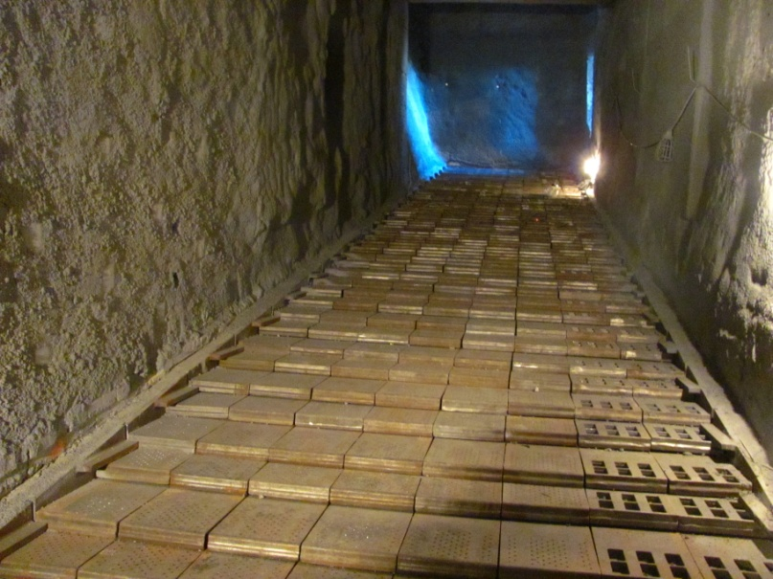
CEMENT PRODUCTION SHUTDOWN – TXI
Project: TXI (Texas Industries, Inc), Hunter, TX
Line 1 Shutdown to Restart Line
Projects P14015 & P14027
Scope: Rebuild & recondition critical components on Line 1 prior to putting line back into production.
Production Equipment:
Clinker Cooler
Reclaimer
Buffer Bin
Heat Exchanger
Other
Cooler Floor

Slide 2
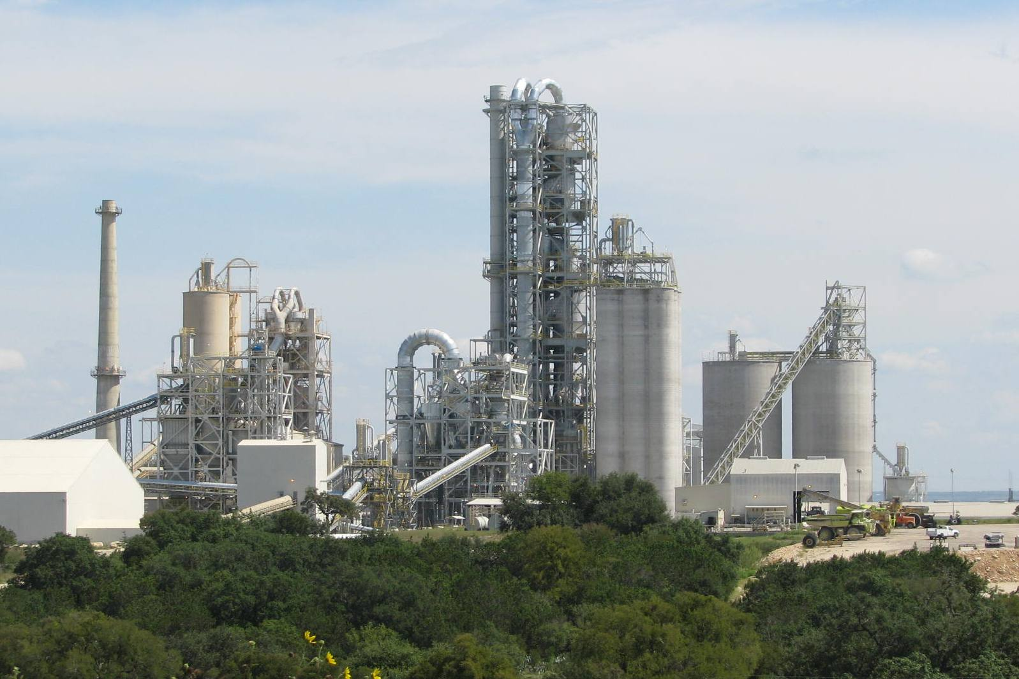
CEMENT PRODUCTION SHUTDOWN – TXI
Equipment Reconditioning – Line 1
Line 1
New - Line 2

Slide 3
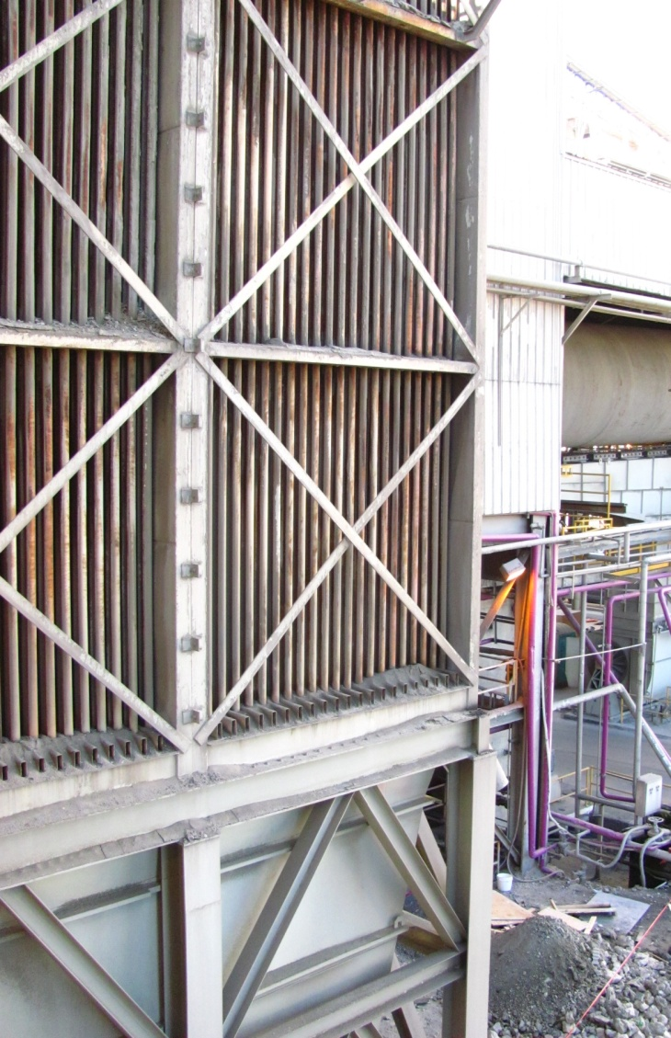
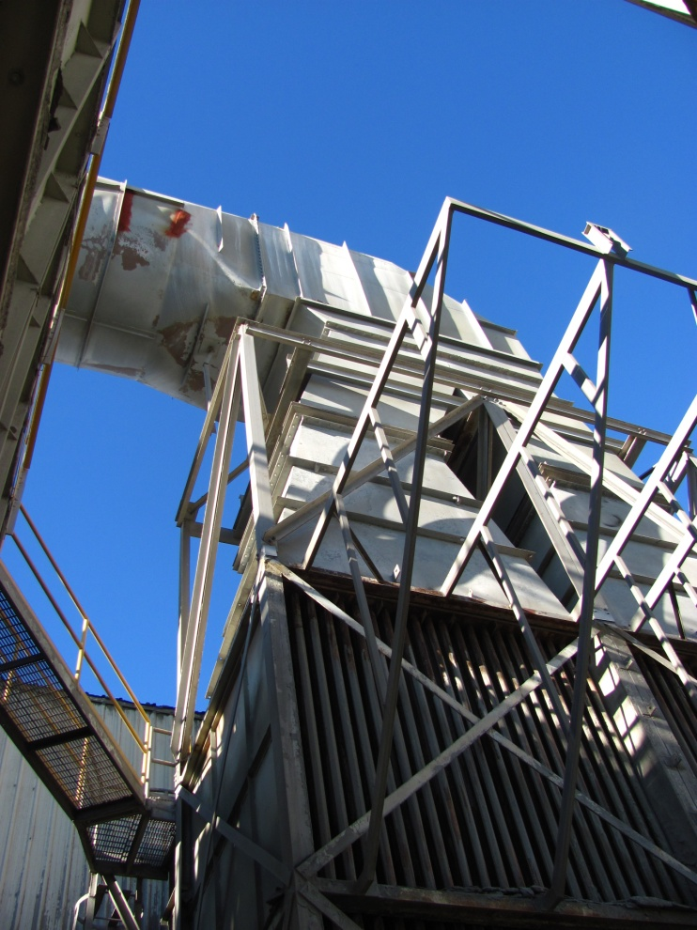
CEMENT PRODUCTION SHUTDOWN – TXI
Equipment Reconditioning – Heat Exchanger Tube Replacement

Slide 4
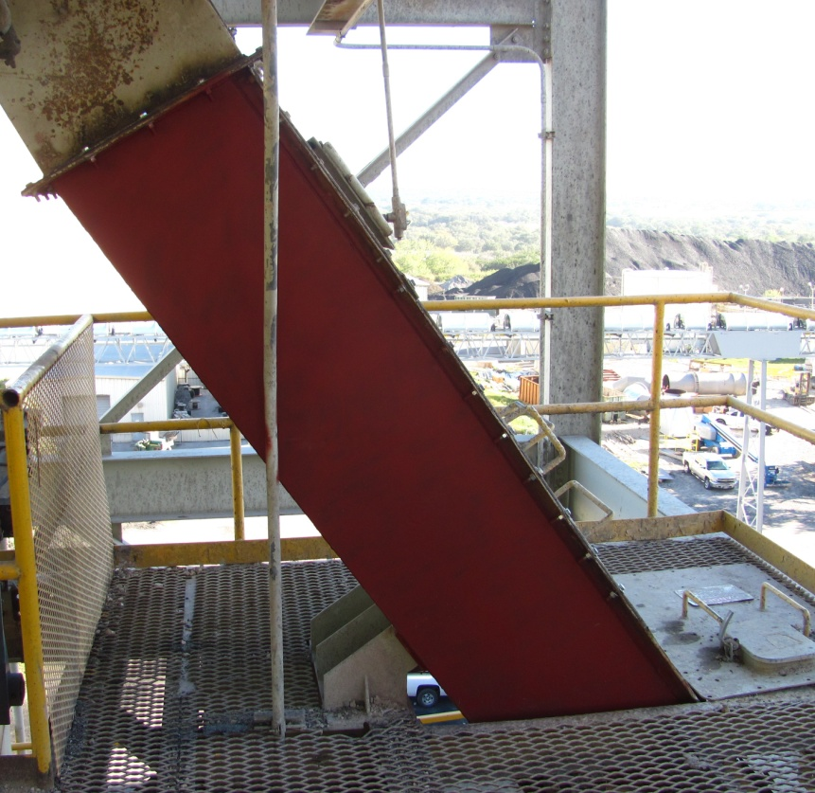
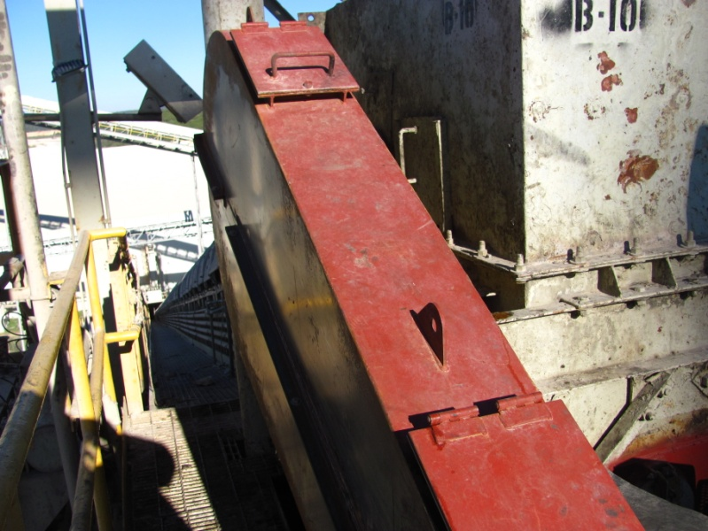
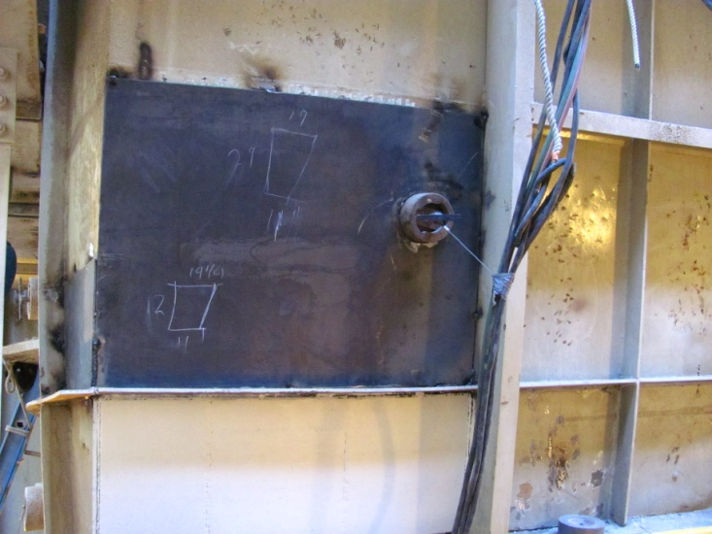
CEMENT PRODUCTION SHUTDOWN – TXI
Equipment Reconditioning
New Guards / Covers
New Chutes
Bin Platework

